Slide 1
Storing Data Using Navigators

Slide 2
Objectives
Understanding to storing data in React Native application
Understanding navigation and working with Navigators components

Slide 3
Storing data

Slide 4
Data management
Most apps manage data as JavaScript objects. For example, data like user info, images, documents, contacts, etc, might be fetched from disk or a remote API, and then stored in-memory as JavaScript objects.
There are several ways to manage data throughout an app, and the best choice depends on the complexity of an app. When in doubt, start simple, and as your application grows in complexity, use something more advanced.

Slide 5
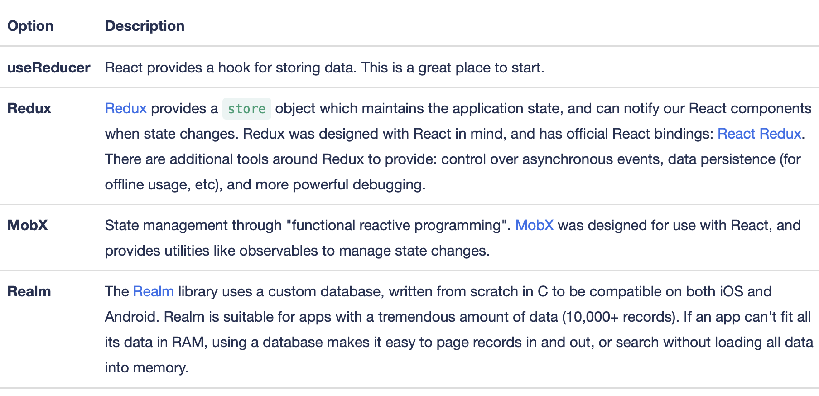
Common options for managing data
Here are a few options worth considering for managing your data.

Slide 6
useReducer
We can use React's useReducer hook to manage our application data.
In this example we'll look at a small To-Do list app that manages its data with useReducer.

Slide 7
useReducer example
Using the terminology from the Project Structure section, this app contains:
A "container" component, App, that connects our application/business logic for adding and removing To-Do items with our UI components
3 "presentational" components that we use to display our UI: List, Input, and Title
A todos file that contains the initial state of our app and a reducer function for updating the state

Slide 8
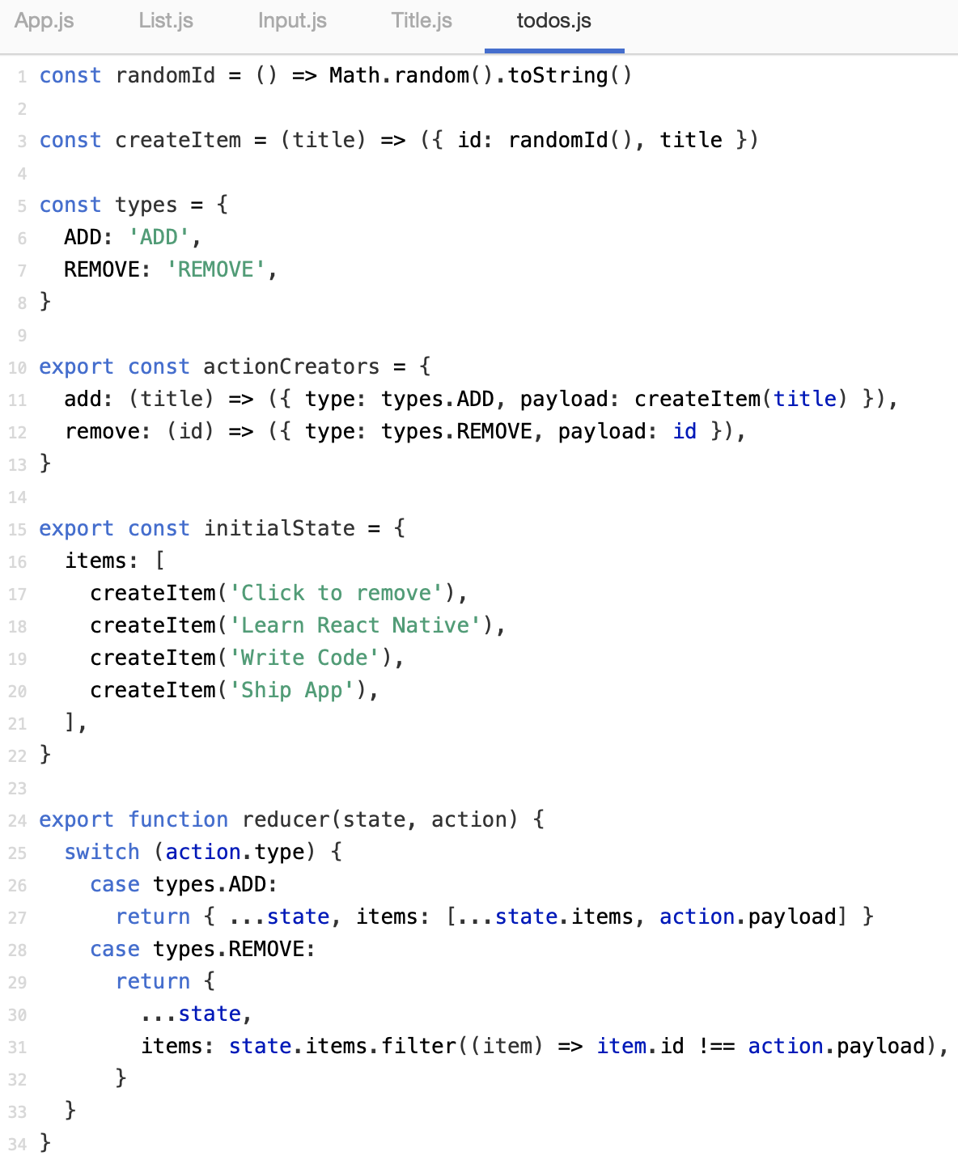
Example

Slide 9
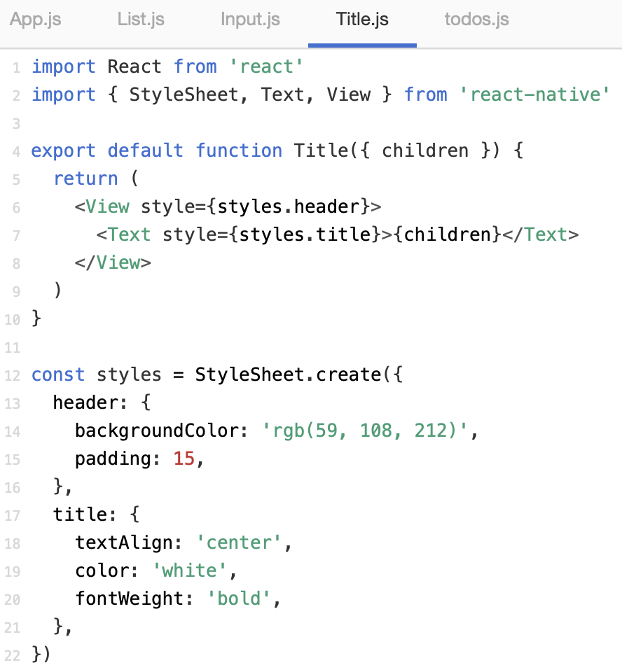
Example (contd.)

Slide 10
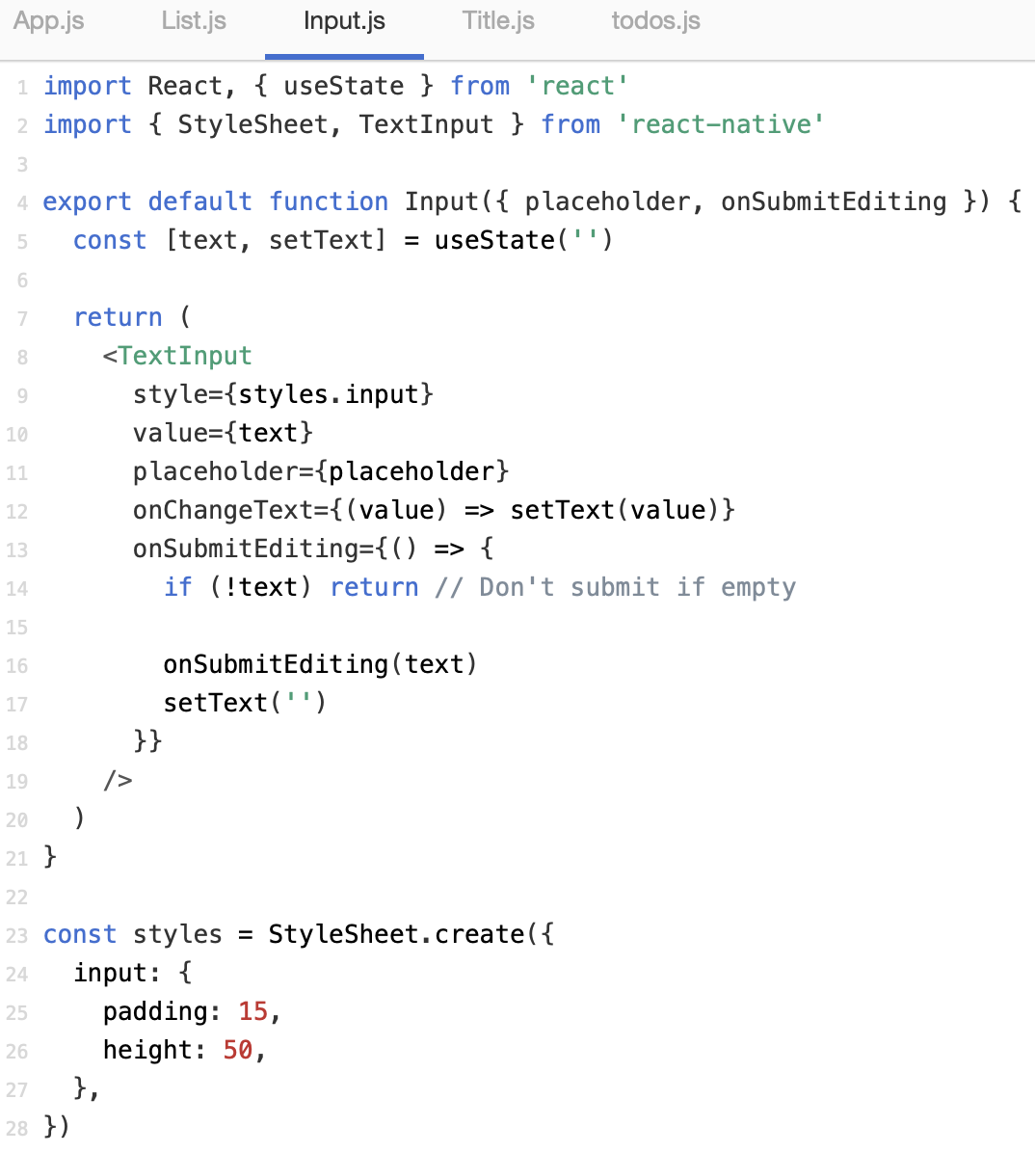
Example (contd.)

Slide 11
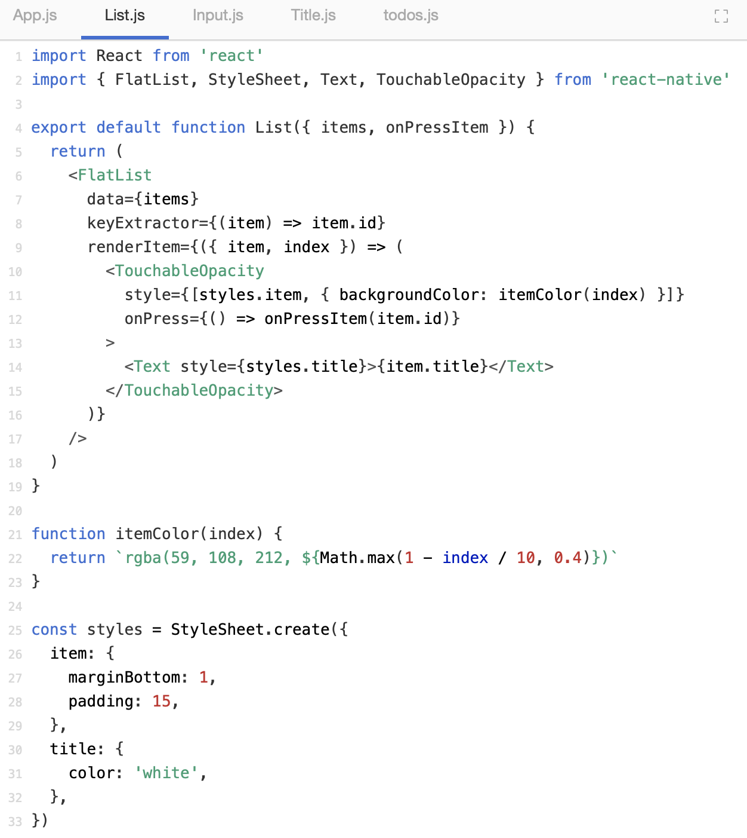
Example (contd.)

Slide 12
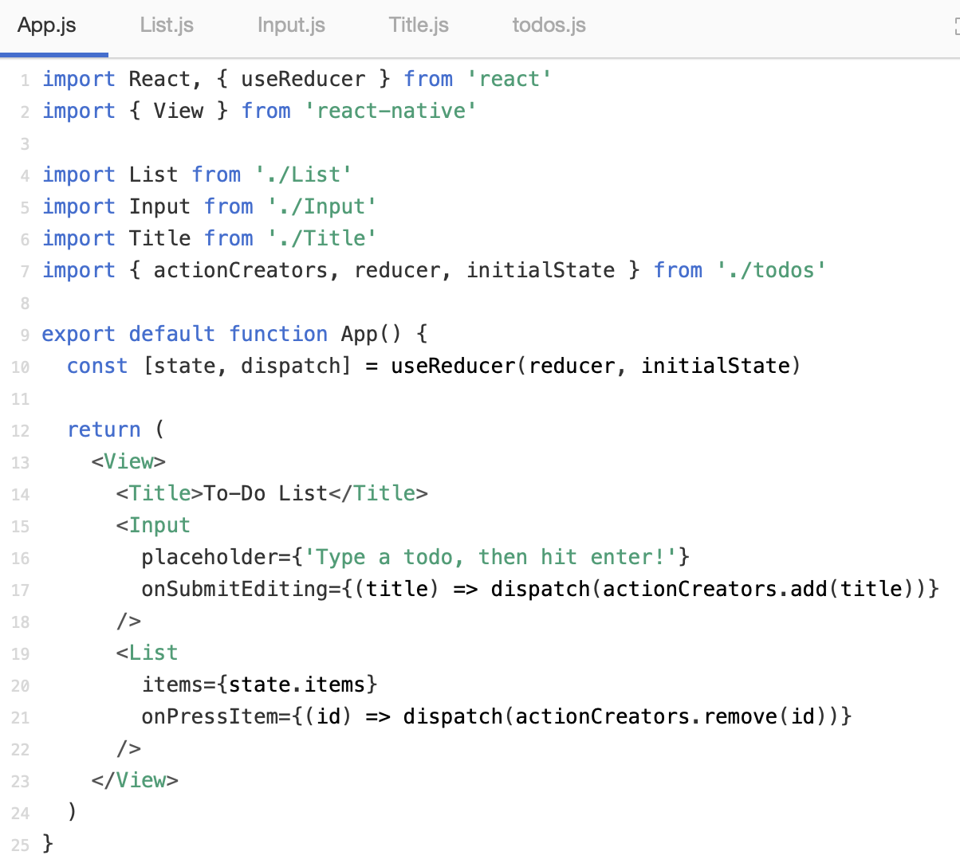
Example (contd.)

Slide 13
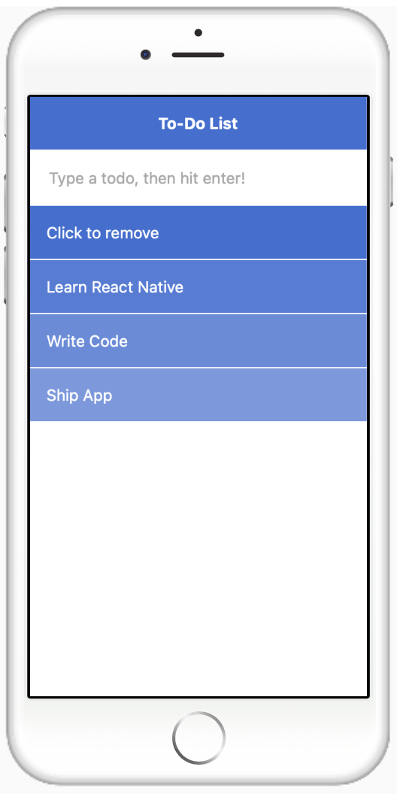
Example (contd.)
Build and Run:

Slide 14
Using Navigators

Slide 15
Navigation
In a web browser, you can link to various pages using an anchor <a> tag. When the user clicks on a link, the URL is pushed to the browser history stack.
When the user clicks on the back button, the browser displays the item from the top of the history stack, so the current page is now the previously visited page.
React Native doesn’t have a built-in concept of a global history stack like a web browser does; this is where React Navigation comes in handy.

Slide 16
Navigation (contd.)
React Navigation’s stack navigator implements a way for your app to transition between screens and maintain navigation history.
A significant variation between how this runs in a web browser and React Navigation is that React Navigation’s stack navigator produces the gestures and animations that you would require on Android and iOS devices when navigating between routes or screens in the stack.

Slide 17
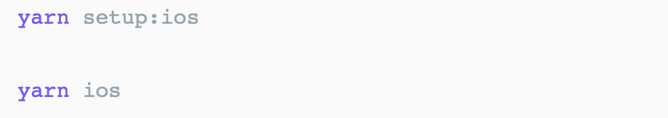
Instalation
Install the required packages in your React Native project:
You need to install the pods ( for IOS) and rebuild application:
> npm install react-native-reanimated react-native-gesture-handler react-native-screens react-native-safe-area-context @react-native-community/masked-view

Slide 18
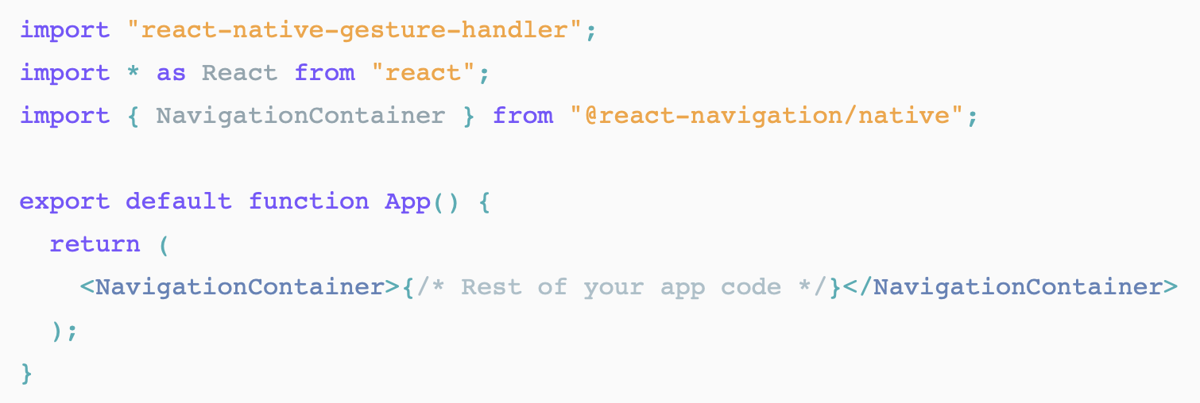
Instalation (contd.)
To finalize installation of react-native-gesture-handler, add the following at the top (make sure it's at the top and there's nothing else before it) of your entry file, such as index.js or App.js:

Slide 19
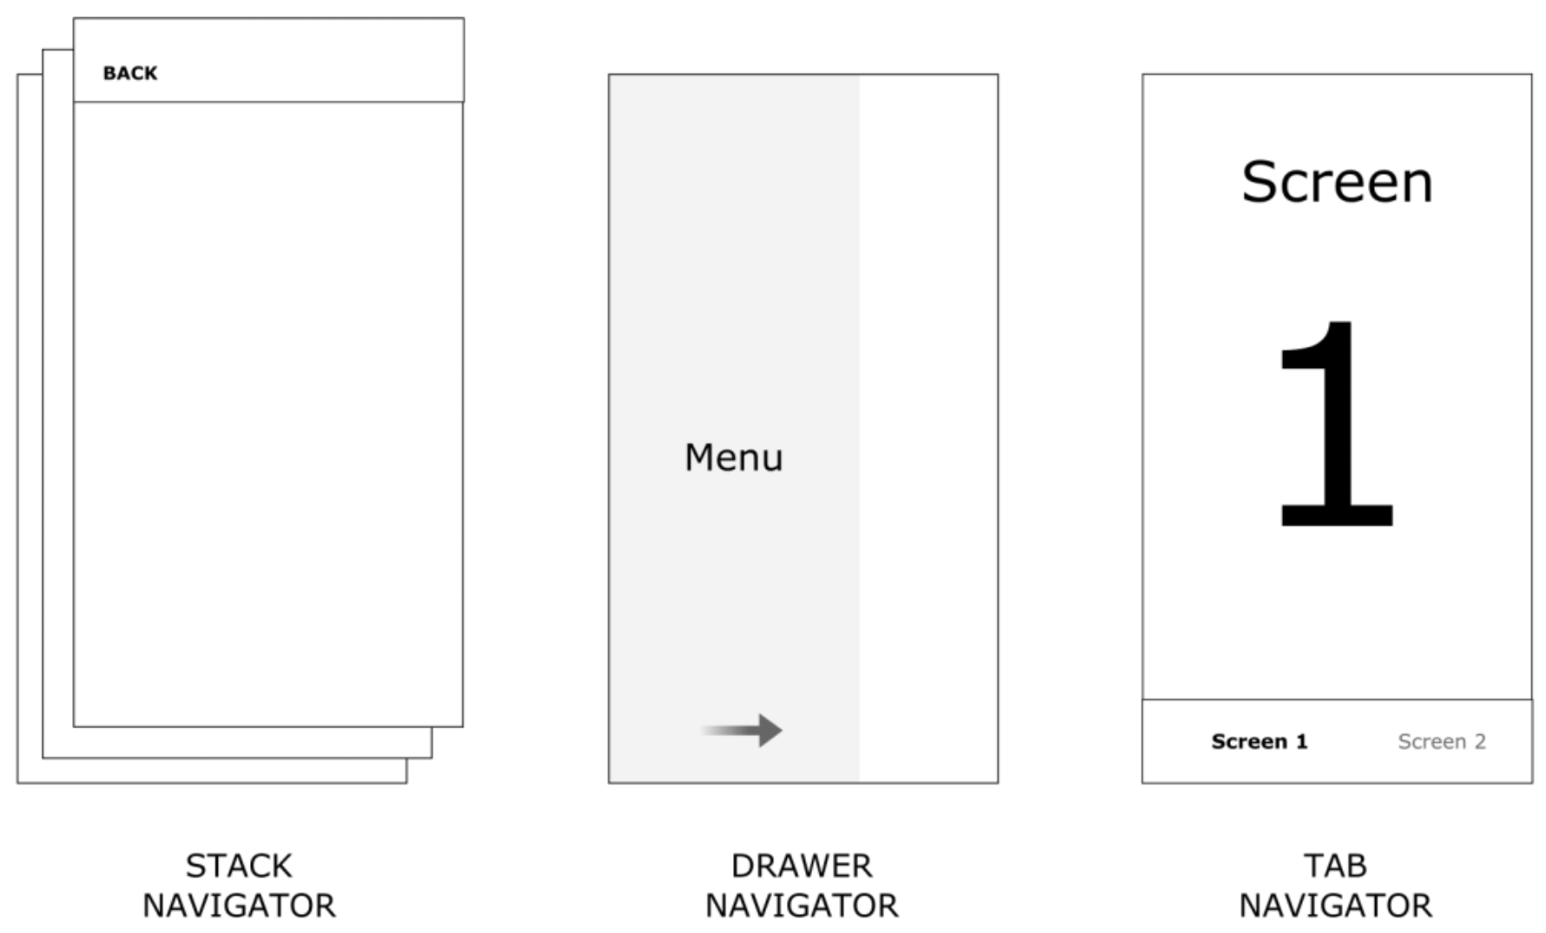
Navigator Components
There are 3 main navigators that React Navigation comes bundled with, that are suitable for both iOS and Android based projects.

Slide 20
Stack Navigator
The most vanilla navigator you’ll find, a Stack navigator will navigate from screen to screen in a hierarchical fashion.
To set up a stack navigator, declare a stack navigator object via the createStackNavigator method. From here, the Navigator and Screen components derived from this method can be used to embed and wrap your desired screens.

Slide 21
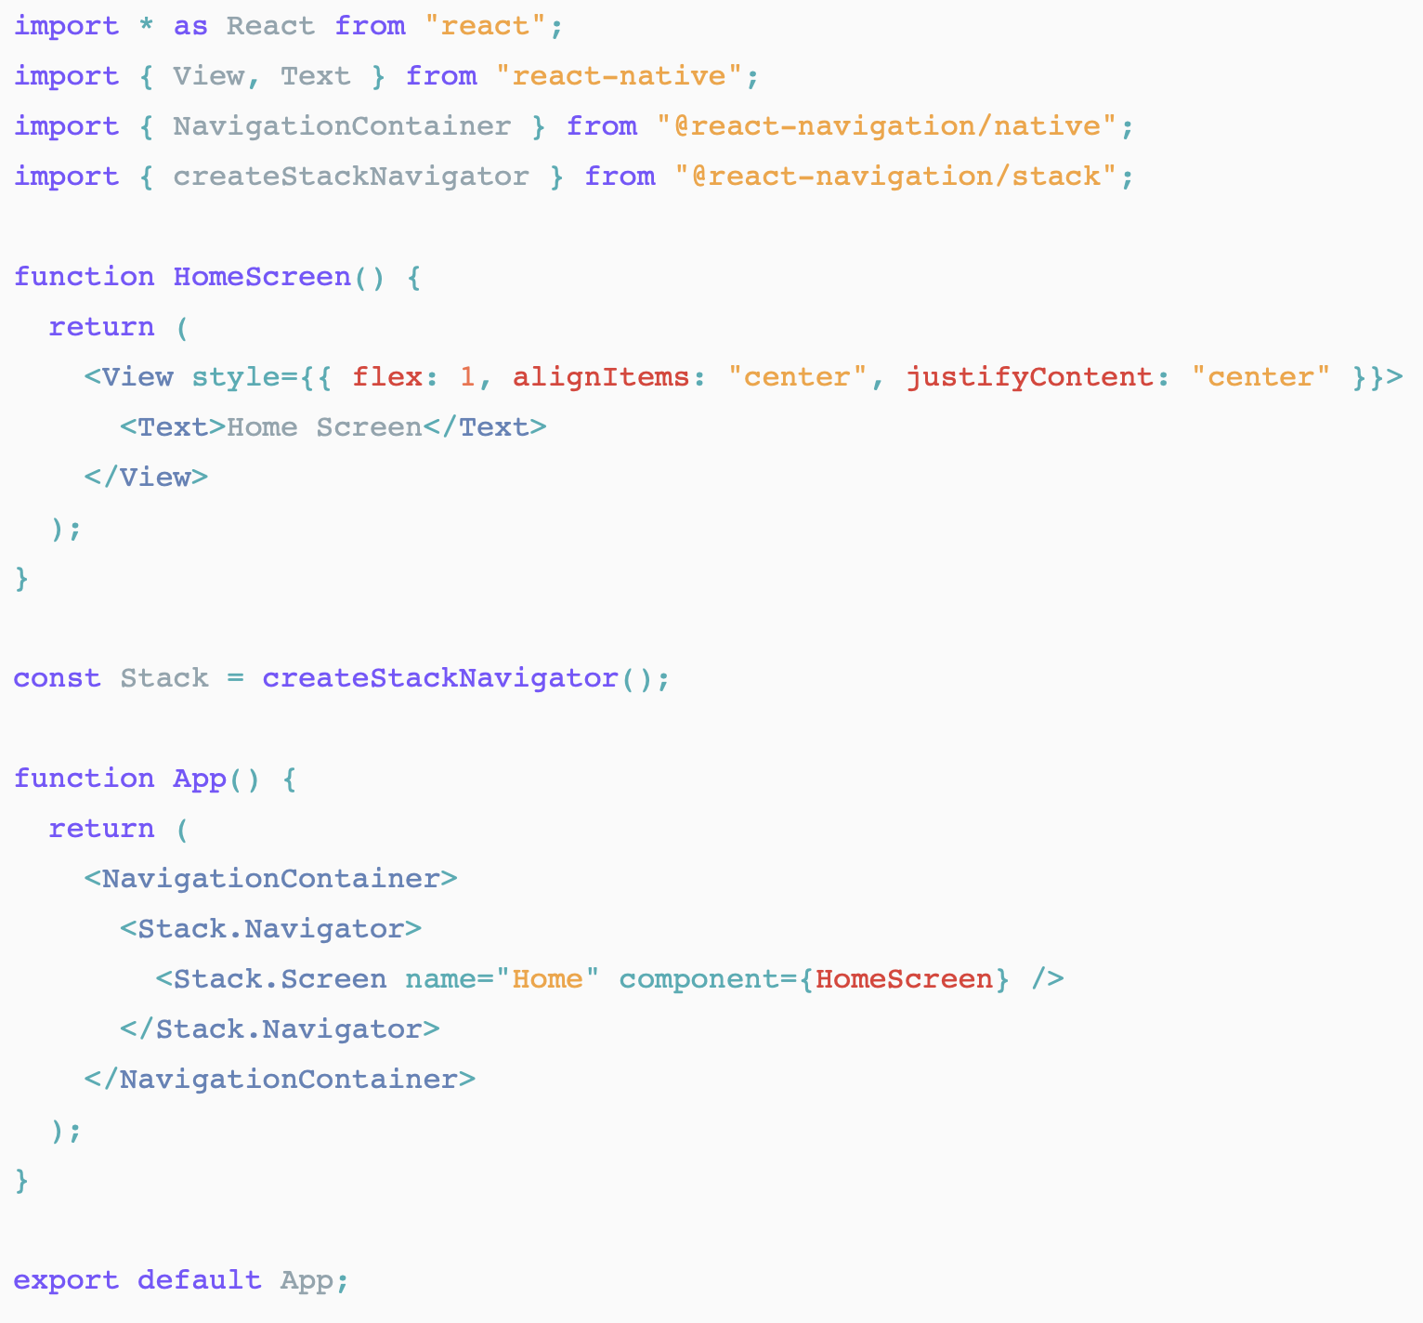
Stack Navigator (contd.)

Slide 22
Bottom Tabs Navigator
Possibly the most common style of navigation in mobile apps is tab-based navigation. This can be tabs on the bottom of the screen or on the top below the header (or even instead of a header).
The following example demonstrates how to construct a Bottom Tabs navigator:

Slide 23
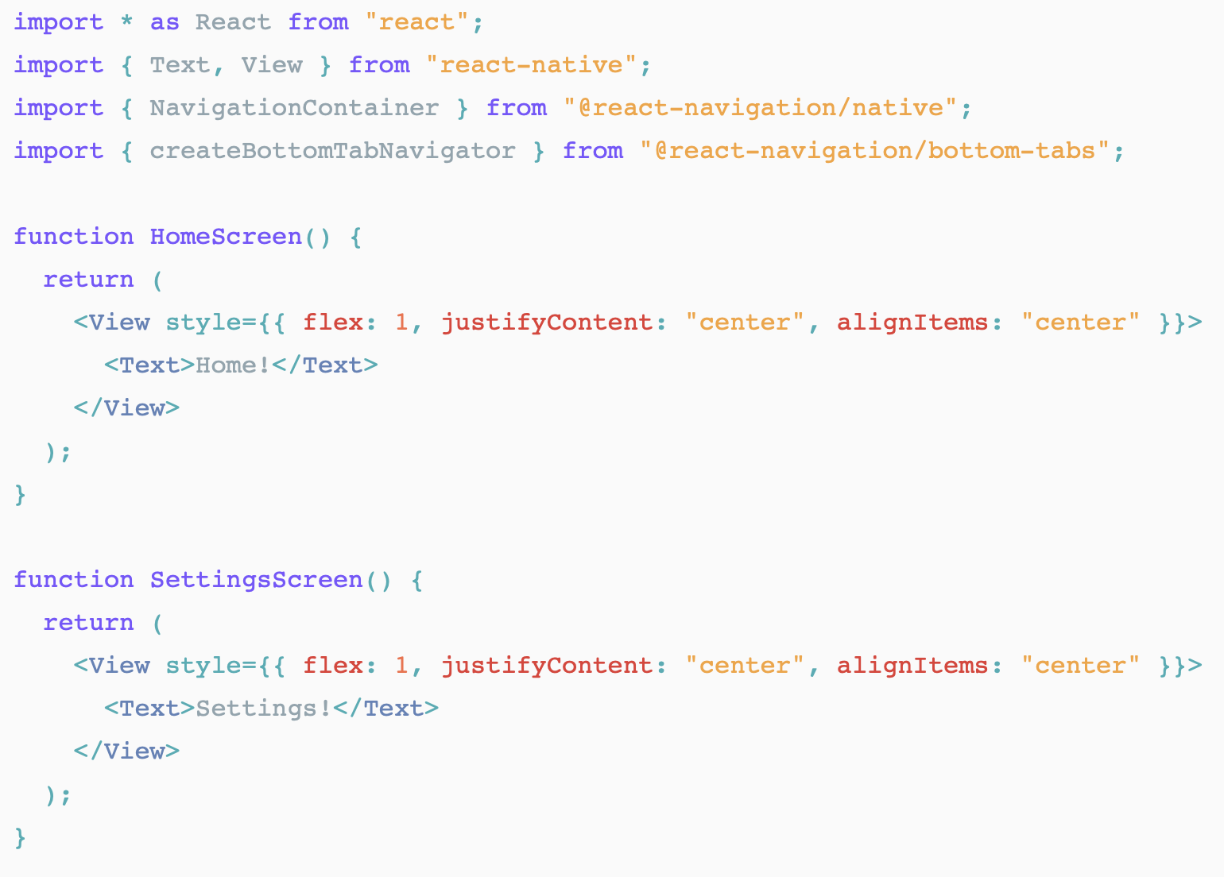
Bottom Tabs Navigator (contd.)

Slide 24
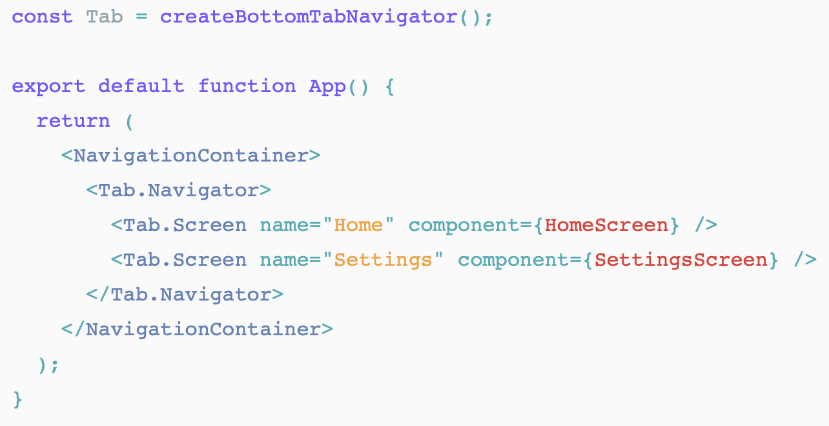
Bottom Tabs Navigator (contd.)

Slide 25
Drawer Navigator
Another useful navigator that allows screens to animate from one side of the screen to be revealed, and animate back when closed. Stack navigators can be nested within these types of navigators to expand on the content within it:
To use this drawer navigator, import it from
@react-navigation/drawer: (swipe right to open)

Slide 26
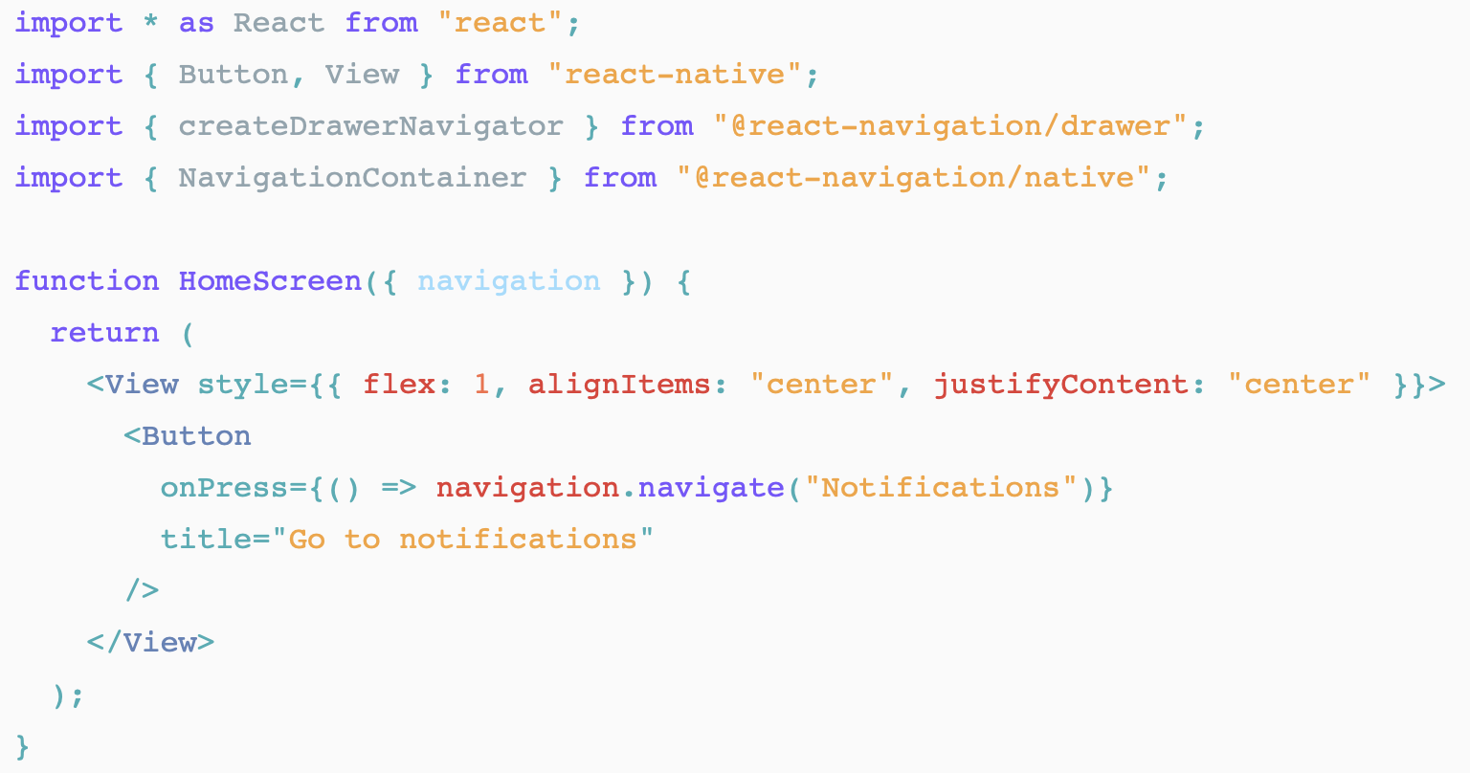
Drawer Navigator (contd.)

Slide 27
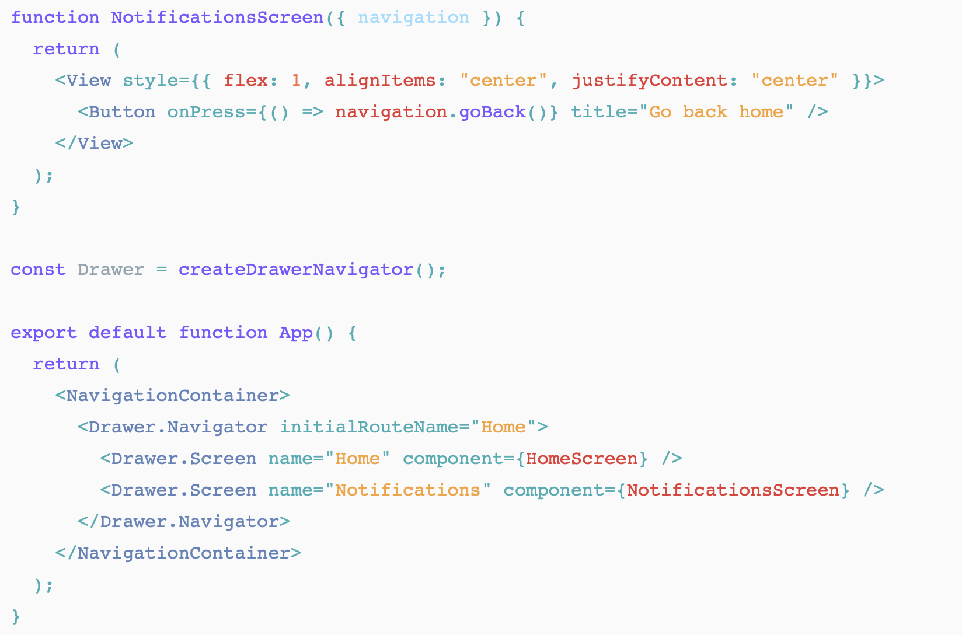
Drawer Navigator (contd.)

Slide 28
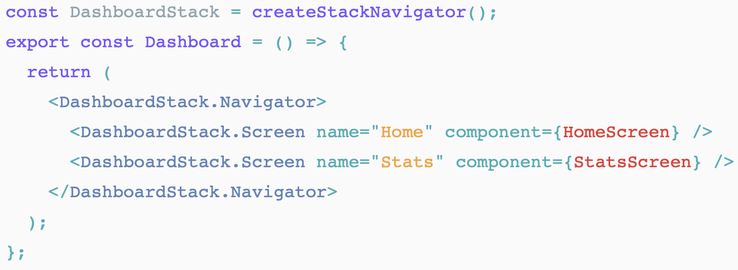
Nesting Navigators
It is common to nest navigators within other navigators, and navigate from one to another. Consider the following setup where a stack navigators are nested within a tab bar navigator:

Slide 29
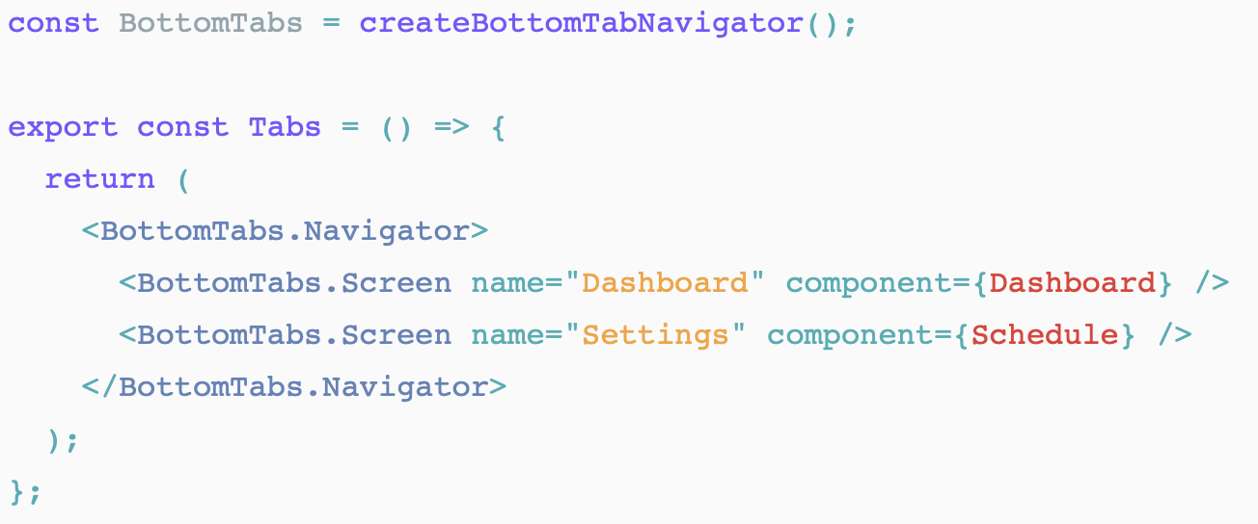
Nesting Navigators (contd.)

Slide 30
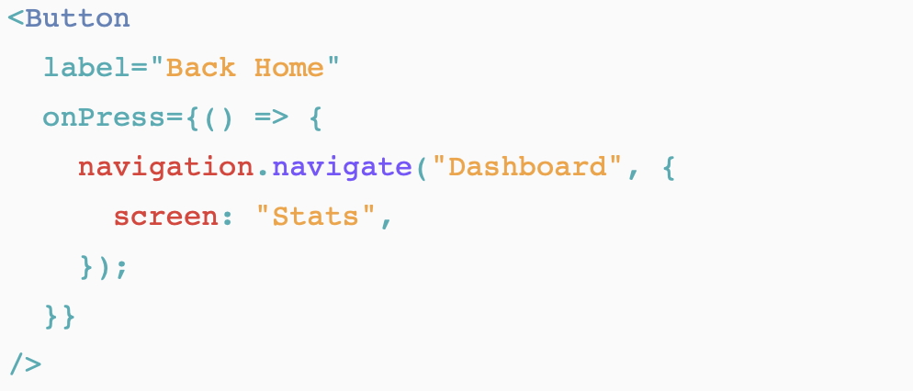
Nesting Navigators (contd.)
What if we wanted to navigate from one tab to a particular stack screen in another tab? Well, React Navigation provides a simple API to do so, using the navigate function within the navigation prop. Consider the following button:

Slide 31
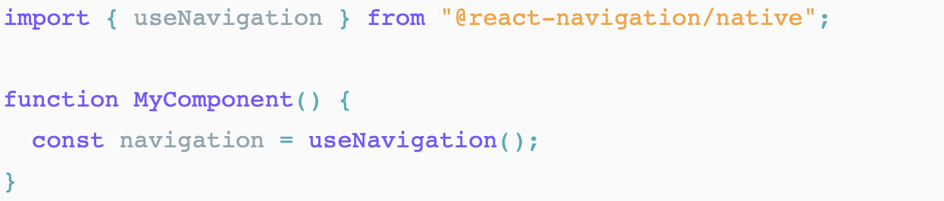
Hooks in React Navigation 5
React Navigation 5 introduction of new hooks , that make it easier to work with navigators within functional components, as well as put less (or no) reliance on HOCs.
The useNavigation: To get navigation object from the navigation container’s context.

Slide 32
Hooks in React Navigation 5 (contd.)
useRoute can also be used to obtain the route object discussed in the previous section. There are a few more hooks to be aware of when upgrading from v4:
useFocusEffect: triggered when the screen in question is focussed. This can replace an event listener setup that you may have relied upon in previous versions.

Slide 33
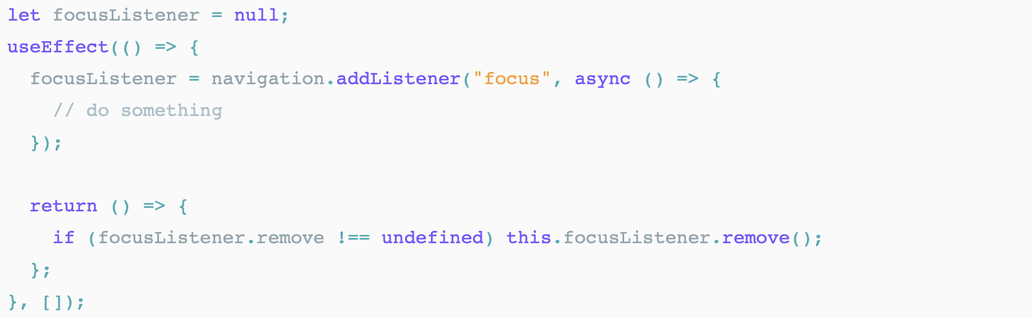
Hooks in React Navigation 5 (contd.)
Event listeners are still supported, but have been simplified. There are now two events of navigation, focus and blur. Before, we had didFocus, willFocus, didBlur and willBlur to play with. focus can be implemented within useEffect like so:

Slide 34
Hooks in React Navigation 5 (contd.)
Notice that focusListener is null by default, as useEffect hooks are triggered after the component renders.
useIsFocused simply checks whether the current screen is focused and returns either true or false.
useLinking deals with deep linking within your app.
Used less frequently will be the useNavigationState hook and useScrollToTop hook, which may be useful for particular use cases you may find yourself implementing.

Slide 35
Summary
In this session, we learned the following:
Understanding to storing data in React Native application
Understanding navigation and working with Navigators components

